Slide 1

Realistic Images Generation
Scientific Computing Department
Faculty Of Computer & Information Science
Ain Shams University

Slide 2
Under Supervision
Dr. Manal Mohsen Tantawi
TA. Radwa Reda Hossieny
Team members
Ahmed Shaaban Abdo Hassan
Ammar Yasser Mahmoud Saad
Ehab Mohamed Abd Elmonem Mohamed
MennatAllah Wael Saed Abd Elwahab
Mohamed Hesham Eldesouky Mohamed
Nada Mohamed Taalab Abdullah

Slide 3
Table of content
01
05
02
06
03
07
08
Recap of Previous Seminar
Summary
Implementation Techniques
What is the next?
Experimental Results
Time Plan
04
Demo
Tools

Slide 4
Problem Definition

Slide 5
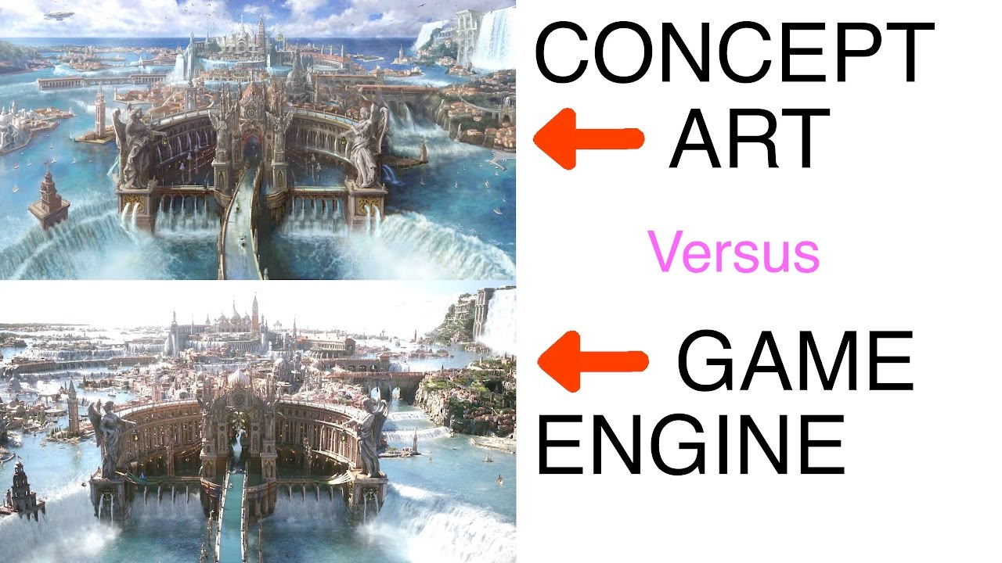
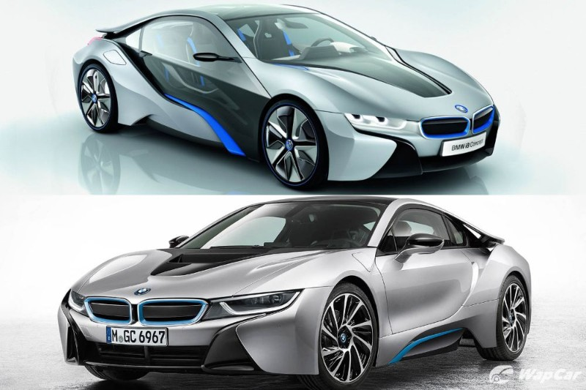
Problem Definition
Designing an object or a product has always been a time and resources consuming task, it can take from weeks to months to design a concept which is too challenging in our rapidly growing world
Getting rid of the concept designing process will not help as this will lead to developing a product that won’t satisfy the requirements which is the main focus in developing product

Slide 6
Motivation

Slide 7
Motivation
Saving time and effort taken by designers to design a concept art, for industry, saving cost of products and speeding up the production process
According to TrueList, the rate of increase in designing field is expected to grow by 3% by the year 2030
Recently, new technologies are developed, but there are not much researches made for them and no clear approvals, that can be used to solve such a problem

Slide 8
Objective

Slide 9
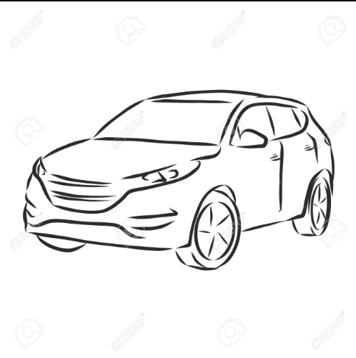
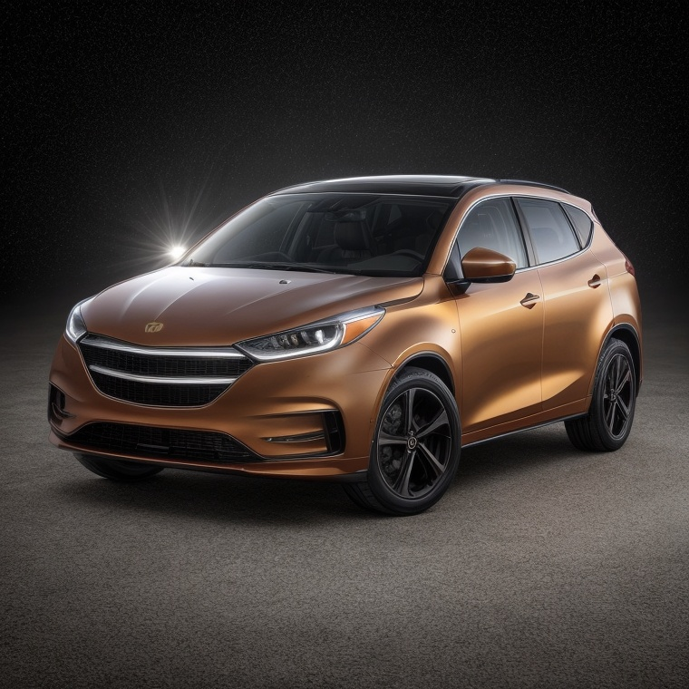
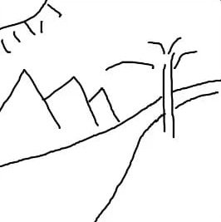

Objective
Our goal is to develop a system that generates images from hand sketches using deep learning to make the process of concepts designing faster and less cost

Slide 10
Survey

Slide 11
Survey
Author | Dataset | Preprocessing | Model | Evaluation
Chengying Gao et al. [1] [2020] | SketchyCOCO | Edge Detection | EdgeGAN | FID: 87.6
Xiaoyu Xiang et al. [2] [2021] | Scribble QMUL-Sketch SketchyCOCO | - | AODA | FID: 114.8
Chengying Gao [3] [2020] | Sketchy-COCO | Sketch Segmentation Edge extraction Attribute vector Generation Resized | Edge GAN | FID = 80.3

Slide 12
Survey
Author | Dataset | Preprocessing | Model | Evaluation
Runtao Liu [1] [2020] | ShoeV2 ChairV2 | Resized | 2-stage model | FID = 48.73
Subhadeep Koley et al. [2] [2023] | ShoeV2 Handbags ChairV2 | Colorization Inpainting Enhancements Style-transfer Simple Arithmetic Operations | StyleGAN | FID=35.85 FID=100.23 FID=90.21
Ankan Kumar Bhunia et al. [3] [2022] | Creative Birds Creative creatures | Resizing Normalization | Doodler Former | FID =16.45 FID =18.71
Yunji Kim et al. [4] [2023] | MS-COCO | - | Dense Diffusion | SOAI: 77.61

Slide 13
Survey cont.
Author | Dataset | Preprocessing | Model | Evaluation
Changqing Zou et al. [8] [2018] | QuickDraw TU-Berlin | semantic Instance segmentation | DeepLab-v3 | OV Acc=88.38
Li Liu et al. [9] [2017] | TU-Berlin Sketchy | - | DSH | MAP: 0.57 MAP: 0.783
Sheng-Yu Wang et al. [10] [2021] | LSUN QuickDraw | - | Photosketch | FID: 19.94

Slide 14
Survey cont.
Author | Dataset | Preprocessing | Model | Evaluation
Wenjing Huang et al. [5] [2023] | COCO-Animals | Augmentation Sampling Encoding Adding Noise | PFB | FID: 6.259
Muyang Li et al. [6] [2021] | Edges2shoes Edges2 Handbags | Resizing Converting to arrays Normalization | Conditional GAN | FID =96.514 FID =130.325
Yongyi Lu [7] [2018] | CelebA CUB-200 Stanford's Cars | XDoG Photocopy simplified | Contextual GAN | Accuracy = 99.8

Slide 15
Survey cont.
Author | Dataset | Preprocessing | Model | Evaluation
Wengling Chen et al. [14] [2018] | ImageNet COCO | Filter Normalization Resize | SketchyGAN | Inception Score = 7.91
Wengling Chen et al. [15] [2018] |  | Normalization Resizing | MRU | Insception Score=7.90

Slide 16
Comments on survey
The most common architectures for this task are GANs.
GANs are much limited to specific domains which gives advantage to Diffusion Models.
Diffusion Models are more generalized which makes them suitable for non-domain-specific problems.
Fréchet inception distance (FID score) score is the common measurement.
Normalization and Resizing are necessary preprocessing steps.

Slide 17
System Architecture

Slide 18
System Architecture
Generative Model
1
2
3
Preprocessing

Slide 19
02
Implementation Results

Slide 20
Common Datasets
Name | QuickDraw | SketchyCOCO (single object version) | TU-Berlin
Size | 50M sketches | 20K triplets (image - sketch - edge map) | 20K sketches for 100K+ images
Categories | 345 categories | 14 categories | 250 categories
Comments | single object sketches labeled with their names | sketches didn’t describe the object in the real image and the images are badly segmented | it’s a large size dataset and non-paired

Slide 21
Common Datasets
Name | SketchyCOCO (single object version) | QuickDraw | TU-Berlin
Size | 20K triplets (image - sketch - edge map) | 50M sketches | 20K sketches for 100K+ images
Categories | 14 categories | 345 categories | 250 categories
Comments | sketches didn’t describe the object in the real image and the images are badly segmented | single object sketches labeled with their names | it’s a relatively small size dataset with a single object in the scene which makes it an ideal start

Slide 22
Datasets
The single object version of SketchyCOCO had sketches that don’t describe the shape and pose of the real image and the real image was a badly cropped version on a white background of the scene images which destroyed the images.
While the large size of TU-Berlin as well as being non-paired made it difficult to utilize this dataset in our project which is limited by our hardware specification that this will require more resources for storing and pairing of sketches and images.
Solution: Collect a Custom Dataset

Slide 23
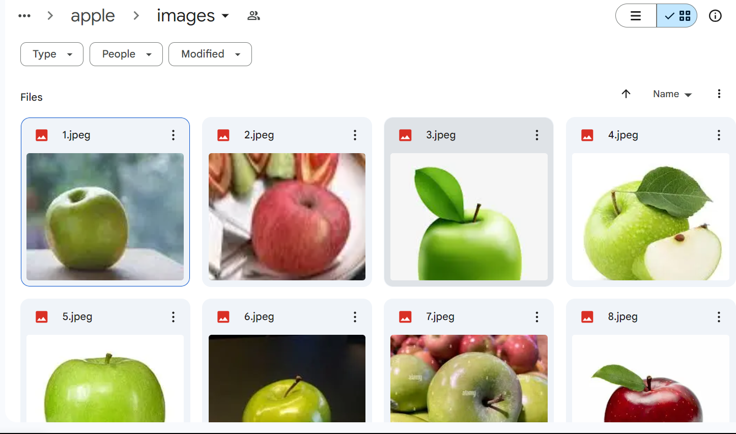
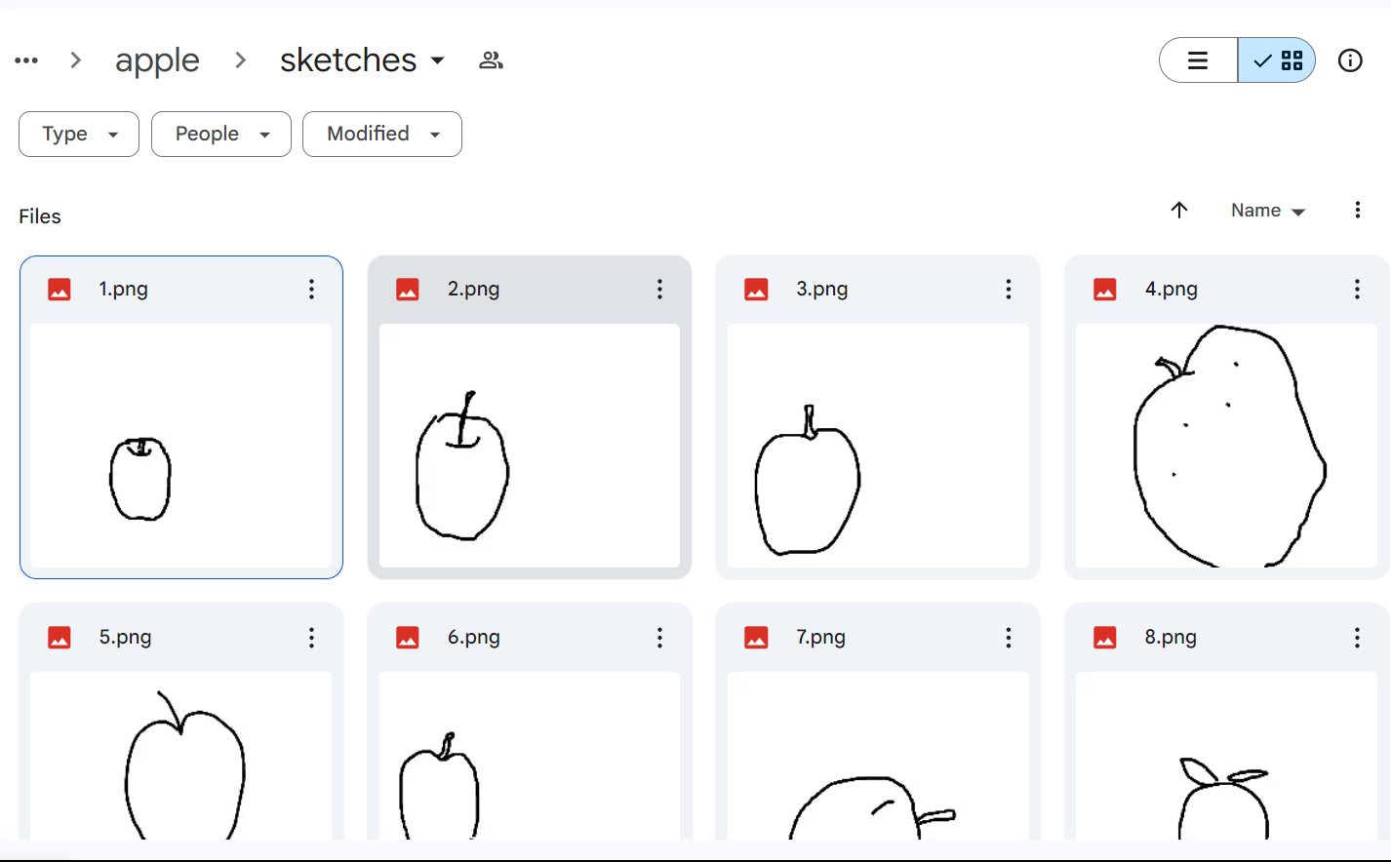
Selected Datasets: Collected Dataset
Real Images were collected from 3 different public datasets.
corresponding sketches were collected from QuickDraw dataset
11 classes were collected, each class containing 20 pairs of images and their corresponding sketches.

Slide 24
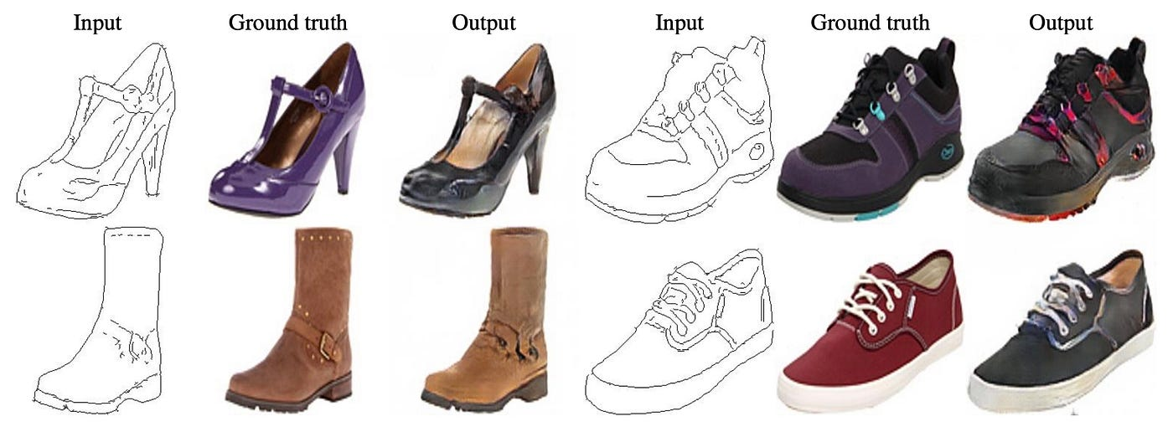
Selected Datasets: pix2pix edges2shoes
comprises paired images of shoe outlines (edges) and their corresponding complete shoe images.
The dataset has 50K image-edges pairs that provide a diverse range of shoe styles, shapes, and textures.
The dataset is a single class dataset with 6 intra-class variations which are snickers, boots, heels, sandals, clogs, and loafers.

Slide 25

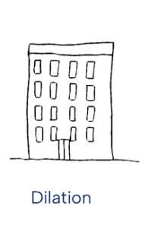

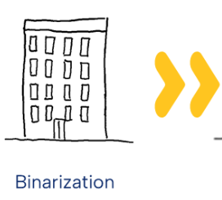

Preprocessing
It is not mentioned as a step when using our selected dataset, so we did the following as enhancement steps:
Resized to 500 x 500
Binarization
Blurring with kernel size 13 x 13
Binarization
Dilation with kernel size 13 x 13

Slide 26
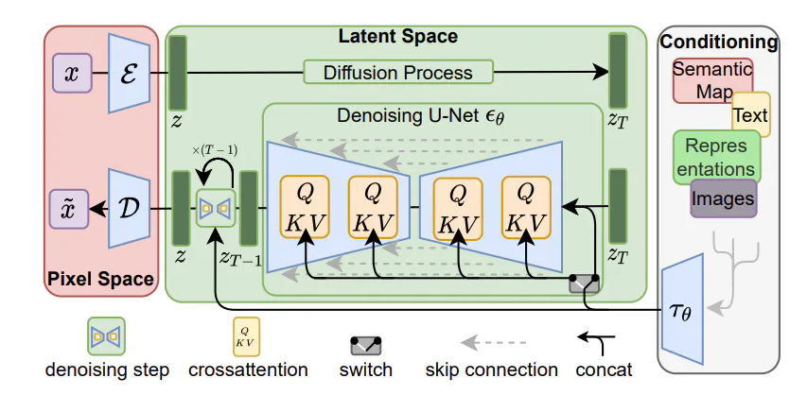
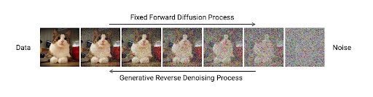
Algorithms: Diffusion Models
The corresponding image is encoded using a condition encoder, denoised by a U-Net denoiser, then decoded using an image decoder.

Slide 27
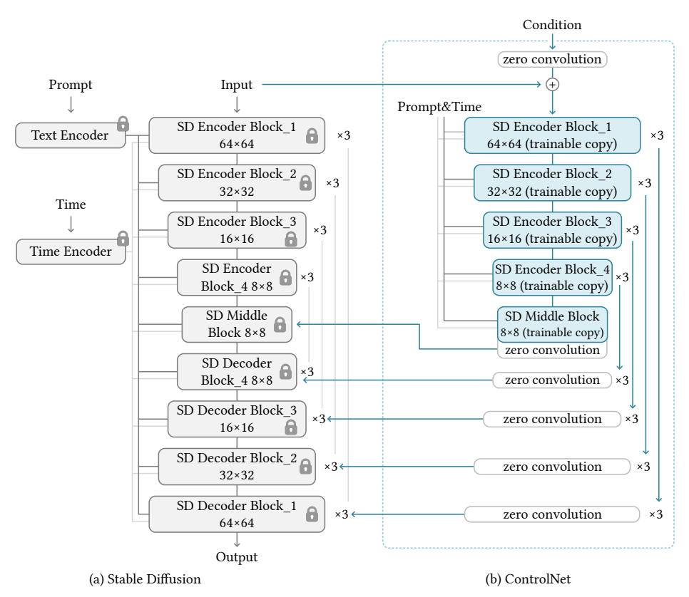
Algorithms: ControlNet
ControlNet is a neural network structure that controls diffusion models by adding extra conditions. It duplicates the weights of neural network blocks into a “locked” copy and a “trainable” copy.

Slide 28
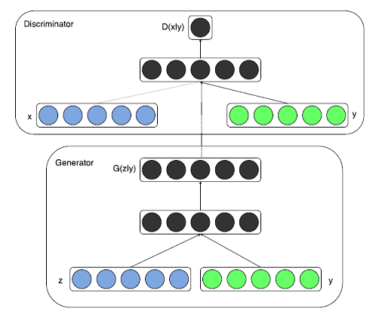
Algorithms: GANs
Basically, a Generative Adversarial Network consists of two parts pitting against each other i.e. the Discriminator and the Generator. The generator takes the role of a forger and learns to map from a latent space to a particular data distribution of interest.

Slide 29

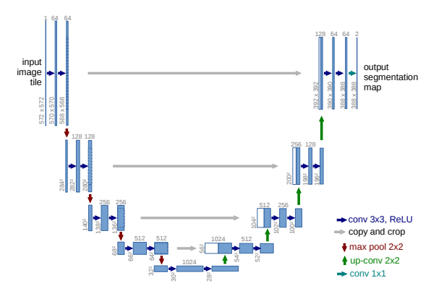

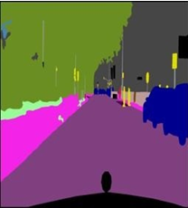
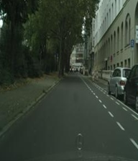
Algorithms: CGAN
Normal GANs create domain-specific images only which means to change the domain we need to train another model on another dataset, that makes appearance of Conditional GAN.
CGAN is a type of GANs that takes a condition as an input to guide the generation process to specific category, in our case the condition is a sketch which is a 2D input.
The generator takes the architecture of U-Net as it’s used for image to image translation tasks such as segmentation, super resolution and generation.
While the discriminator takes the architecture of convolution PatchGANs as it discriminates the image in patches.

Slide 30
03
Experimental Results

Slide 31
Measurement Criteria
Fréchet Inception Distance (FID)
Evaluation method of the quality of generated images from any deep learning models as: GAN, etc.
It measures the difference between the extracted feature vectors from real and generated images.
FID provides a numerical score that indicates the realism of the generated images, with lower scores suggesting higher quality.

Slide 32
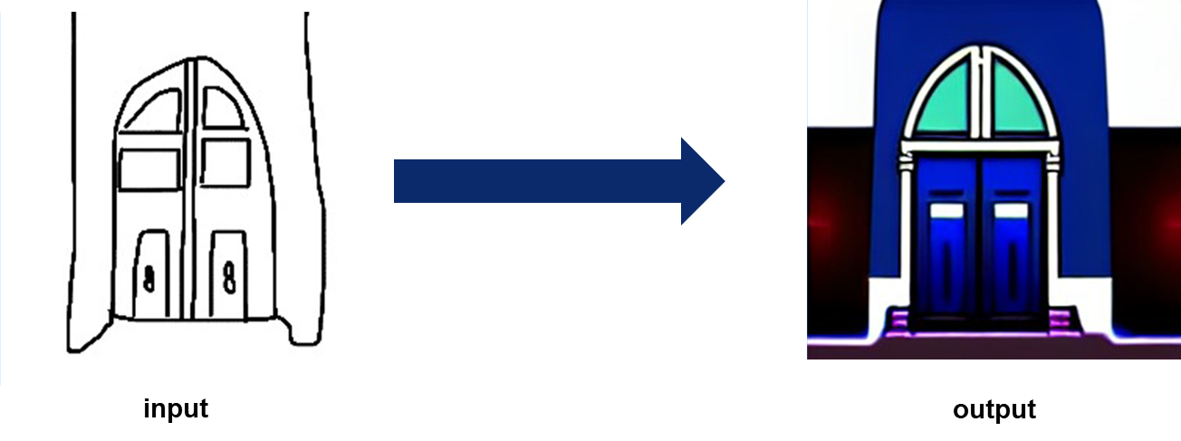
ControlNet
Model Name | The changed parameter |  | FID
ControlNet | No. of epochs | 10 | 7996.29
 | No. of epochs | 20 | 6487.25
 | No. of epochs | 30 | 7550.70

Slide 33
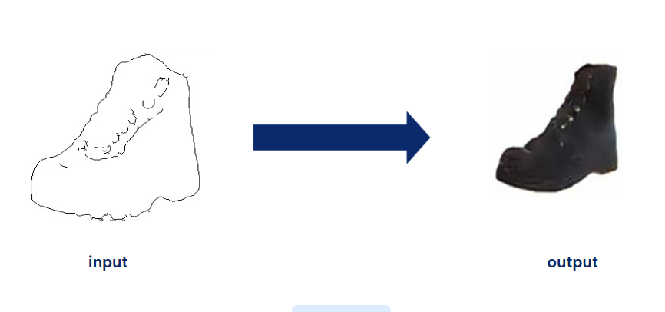
Conditional GAN (CGAN)
Model Name | The changed parameter |  | FID
Conditional GAN (CGAN) | No. of epochs | 50 | 131.04
 | No. of epochs | 100 | 131.78
 | No. of epochs | 150 | 55.02
 | No. of epochs | 200 | 213.52

Slide 34
04
Demo

Slide 35

Demo ( ControlNet )

Slide 36
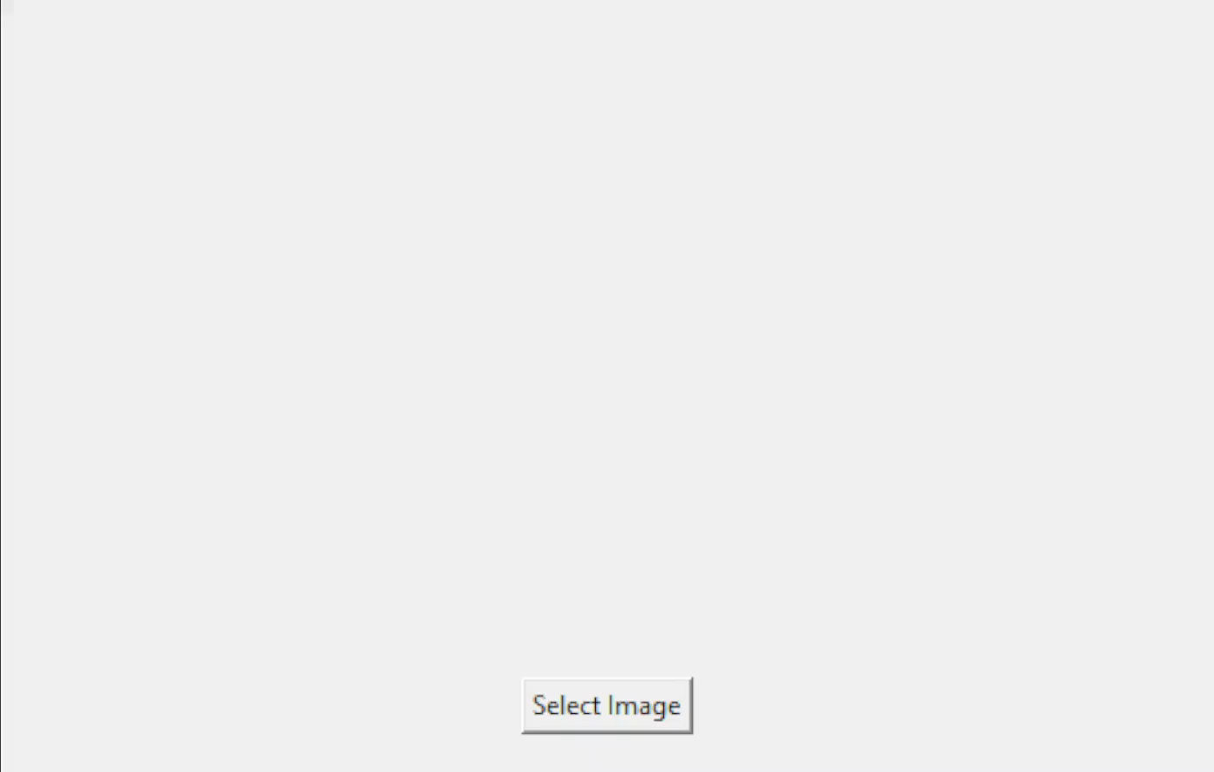
Demo ( CGAN )

Slide 37
05
Summary

Slide 38
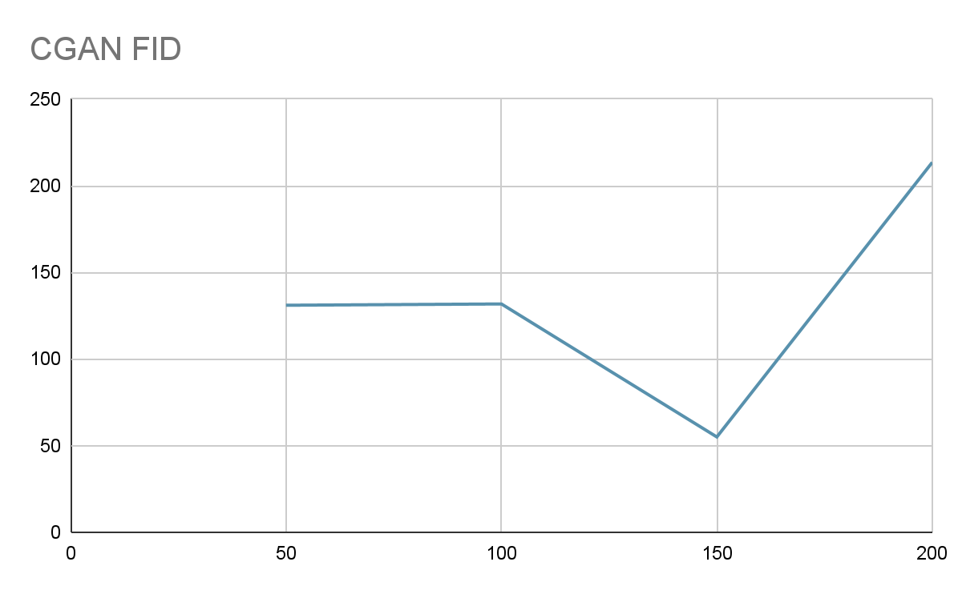
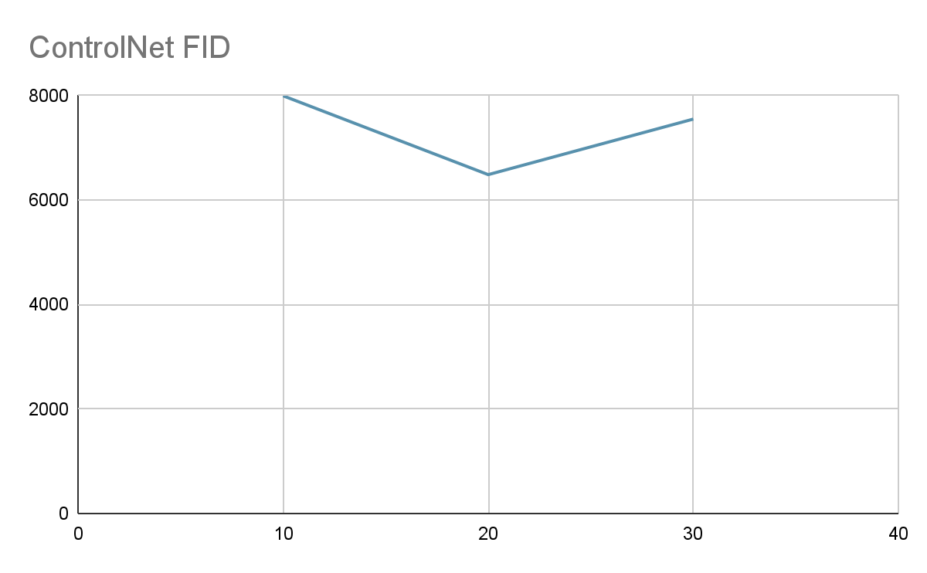
Summary
Two main methodologies are explored: Diffusion Models and Generative Adversarial Networks (GANs).
From Diffusion Models, the ControlNet model is utilized.
From GANs, the Conditional Generative Adversarial Network (CGAN) is implemented.
Number of Epochs
Number of Epochs

Slide 39
06
What is the next?

Slide 40
What is the next?
Improving the interface Based on our model “CGAN”.
If time permits we can try different models like EdgeGAN, ControlNet Depth, T2I Adapter, and DISS.
Finishing the documentation.

Slide 41
07
Time Plan

Slide 42
Time Plan
Phase Name | Oct 2023 | Nov 2023 | Dec 2024 | Jan 2024 | Feb 2024 | Mar 2024 | Apr 2024 | May 2024 | Jun 2024
Survey about related work
Dataset Selection
Project Design and Architecture
Implementation
Testing and Integration
Deployment
Demo Release
Documentation

Slide 43
08
Tools

Slide 44






Tools
Python
Colab
Kaggle
PyTorch
Flask
React JS, Node JS

Slide 45
References

Slide 46
References
Runtao Liu, Qian Yu, and Stella Yu - Unsupervised Sketch-to-Photo Synthesis - Peking University (2020)
Subhadeep Koley, Ayan Kumar Bhunia, Aneeshan Sain - Picture that Sketch: Photorealistic Image Generation from Abstract Sketches - University of Surrey, United Kingdom (2023)
Li Liu, Fumin Shen, Yuming Shen Xianglong Liu - Deep Sketch Hashing - University of Electronic Science and Technology of China (2017)
Yunji Kim, Jiyoung Lee, Jin-Hwa Kim, Jung-Woo Ha, Jun-Yan Zhu - Dense Text-to-Image Generation with Attention Modulation - Carnegie Mellon University (2023)
Wenjing Huang, Shikui Tu, Lei Xu, Shanghai Jiao, Tong University - PFB-Diff: Progressive Feature Blending Diffusion for Text-driven Image Editing (2023)
Muyang Li, Ji Lin, Yaoyao Ding, Zhijian Liu, Jun-Yan Zhu and Song Han - GAN Compression: Efficient Architectures for Interactive Conditional GANs - IEEE (2021)
Yongyi Lu ,Shangzhe Wu,Yu-Wing Tai - Sketch Constraint Using Contextual GAN - University of Oxford (2018)

Slide 47
References
Chengying Gao, Qi Liu, Qi Xu, Limin Wang, Jianzhuang Liu, Changqing Zou (2022) SketchyCOCO: Image Generation from Freehand Scene Sketches
Xiaoyu Xiang, Ding Liu, Xiao Yang, Yiheng Zhu, Xiaohui Shen, Jan P. Allebach (2021) Adversarial Open Domain Adaptation for Sketch-to-Photo Synthesis
Chengying Gao, Qu Liu, Limin Wang, Jianzhuang Liu, and Changqing Zou - SketchyCOCO: Image Generation from Freehand Scene Sketches - HMI Lab, Huawei Technologies (2020)
Runtao Liu, Qian Yu, and Stella Yu (23.3.2020) Unsupervised Sketch-to-Photo Synthesis
Picture that Sketch: Photorealistic Image Generation from Abstract Sketches
Li Liu et al.(2017), Deep Sketch Hashing
Yunji Kim, Jiyoung Lee, Jin-Hwa Kim, Jung-Woo Ha, Jun-Yan Zhu (2023) Dense Text-to-Image Generation with Attention Modulation

Slide 48
References
SketchyScene: Richly-Annotated Scene Sketches
Sheng-Yu Wang, David Bau, Jun-Yan Zhu (2021) Sketch Your Own GAN
Wenjing Huang, Shikui Tu, Lei Xu, Shanghai Jiao, Tong University - PFB-Diff: Progressive Feature Blending Diffusion for Text-driven Image Editing (2023)
Yongyi Lu ,Shangzhe Wu,Yu-Wing Tai, (2018) , Sketch Constraint Using Contextual GAN
Hangyu Lin, Yanwei Fu , (2020) ,Sketch-BERT: Learning Sketch Bidirectional Encoder Representation
SketchyGAN: Towards Diverse and Realistic Sketch to Image Synthesis

Slide 49
Thanks!
Do you have any questions?

